Slide 1
Spring Cloud Distributed Tracing using zipkin

Slide 2
Distributed Tracing using Zipkin
Distributed tracing is a technique used to profile and monitor applications, especially those built using the microservice architecture.
Distributed tracing, also called distributed request tracing. IT and DevOps teams can use distributed tracing to monitor applications.
It identifies the failed microservices or the services having performance issues when there are many services call within a request.
It is very useful when we need to track the request passing through the multiple microservices. It is also used for measuring the performance of the microservices.

Slide 3
Zipkin
Zipkin is a distributed tracing system. It helps gather timing data needed to troubleshoot latency problems in service architectures.
Too many things could happen when a request to an HTTP application is made. A request could include a call to a database engine, to a cache server, or any other dependency like another microservice.
An application could be sending timing data in the background so that when it’s time to troubleshoot, it can have an integrated view with Zipkin.

Slide 4
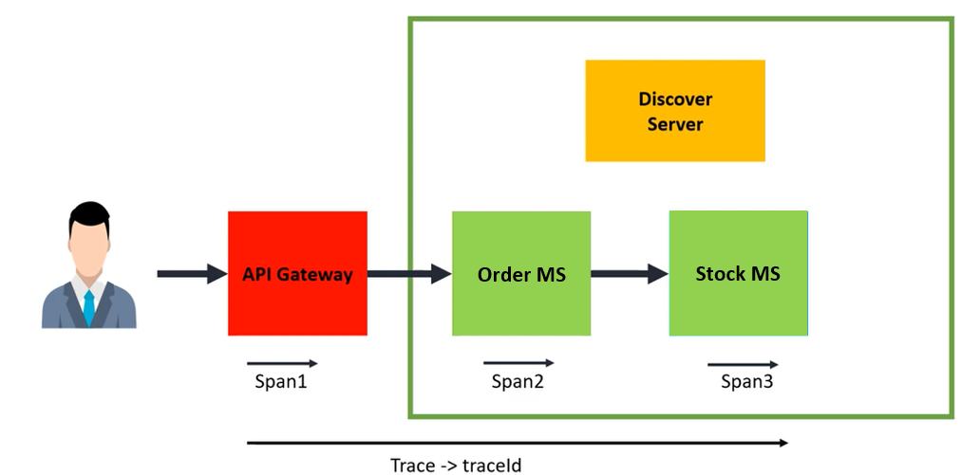
Zipkin – Why?
Consider Flight Ticking Booking Application:

Slide 5
Zipkin – Key Terminologies
Trace: It can be used to represent the whole journey as it propagates through a distributed system and contains multiple spans.
Trace ID: Every trace contains one unique ID that can be named Trace ID, and it can be used to identify the traces uniquely in the Zipkin tracing service.
Span: It can represent a single unit of work within a trace, and it contains information that includes the operation of the request, timing information, metadata, and also the initial request and downstream calls.
Span ID: It can be used to uniquely identify the spans within a trace service, and all spans within the same trace share the same trace ID.
Parent Span ID: It can represent the initial span of the traces, and it can establish the hierarchy of spans in the Zipkin trace service.

Slide 6
Zipkin – Key Terminologies
Trace Context: It can contain the data of the Trace ID, Span ID, and parent Span ID that were propagated along with the request as a traversal through the different services.
Sampler: It is responsible for deciding which requests should be traced and which are not, and it helps to control a subset of requests.
Reporter: It can generate reports of the sending of span data to the tracing backend, and it can store and analyze the traces.
Zipkin UI Dashboard: It can represent the UI dashboard interface of the Zipkin server, and it can visualize traces, analyze performance, and identify issues with the systems.

Slide 7
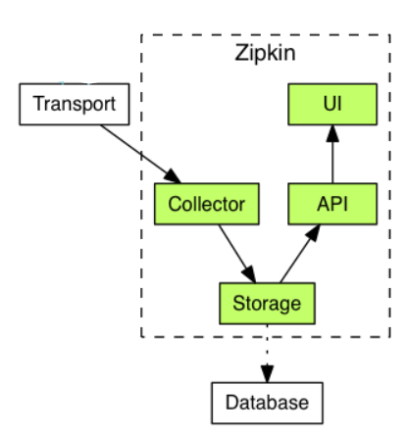
Zipkin – Architecture

Slide 8
Zipkin - Components
Zipkin Collector
Once the trace data arrives at the Zipkin collector daemon, it is validated, stored, and indexed for lookups by the Zipkin collector.
Storage
Zipkin was initially built to store data on Cassandra since Cassandra is scalable, has a flexible schema, and is heavily used within Twitter. However, it made this component pluggable. In addition to Cassandra, it natively support ElasticSearch and MySQL. Other back-ends might be offered as third party extensions.

Slide 9
Zipkin - Components
Zipkin Query Service
Once the data is stored and indexed, we need a way to extract it. The query daemon provides a simple JSON API for finding and retrieving traces. The primary consumer of this API is the Web UI.
Web UI
We created a GUI that presents a nice interface for viewing traces. The web UI provides a method for viewing traces based on service, time, and annotations. Note: there is no built-in authentication in the UI!

Slide 10
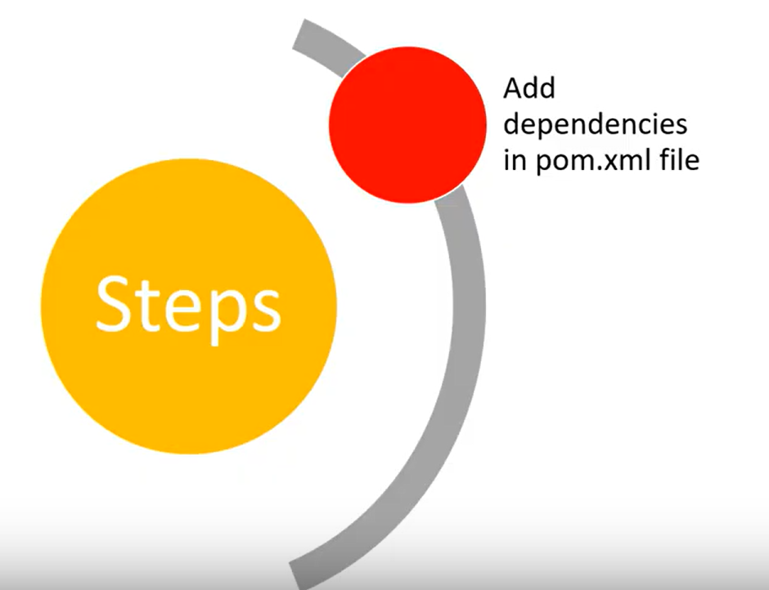
Implement Distributed Tracing using Zipkin

Slide 11
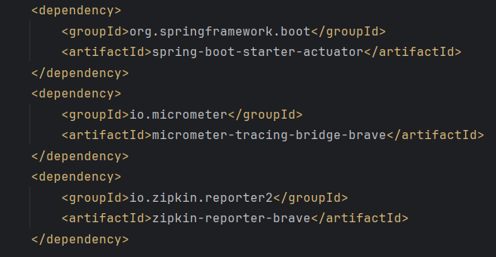
Implement Distributed Tracing using Zipkin

Slide 12
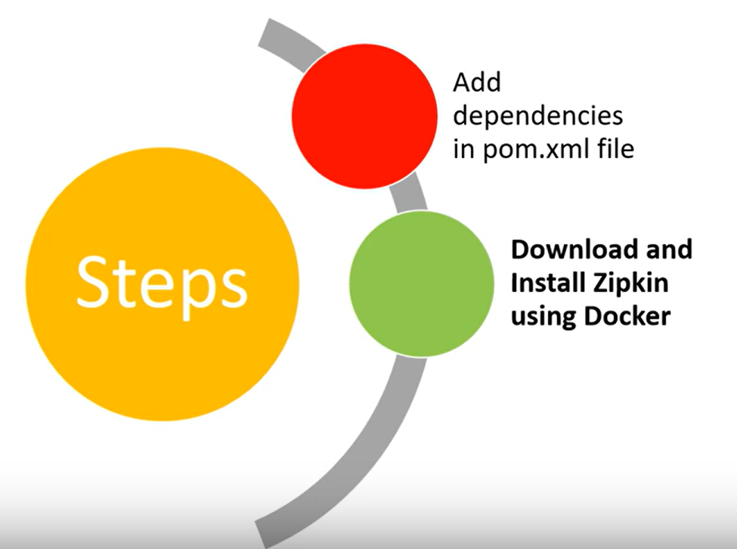
Implement Distributed Tracing using Zipkin

Slide 13
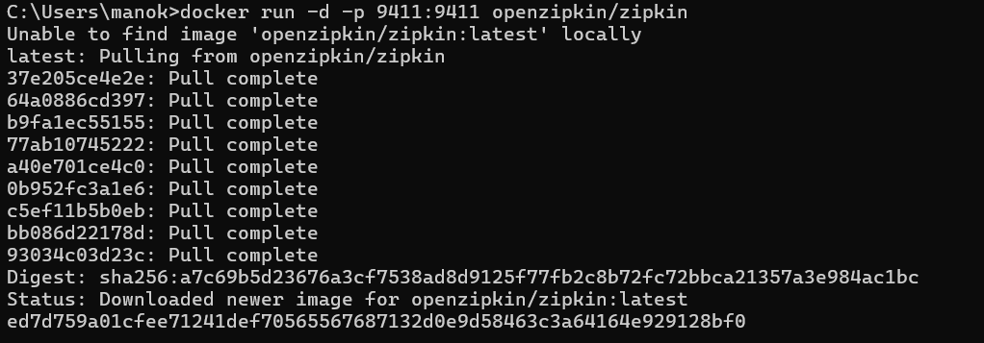
Implement Distributed Tracing using Zipkin
Zipkin Server application can be installed with your machine using Docker, Java and Homebrew.
Use Official link to download and install zipkin
https://zipkin.io/pages/quickstart

Slide 14
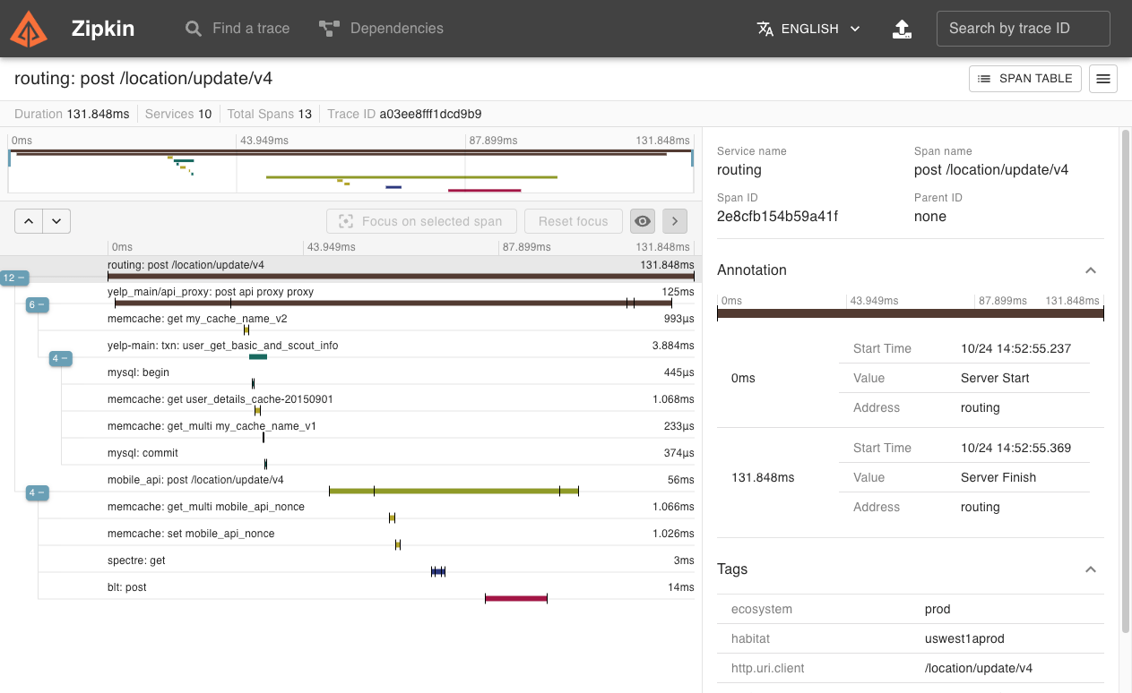
Zipkin – UI Console

Slide 15
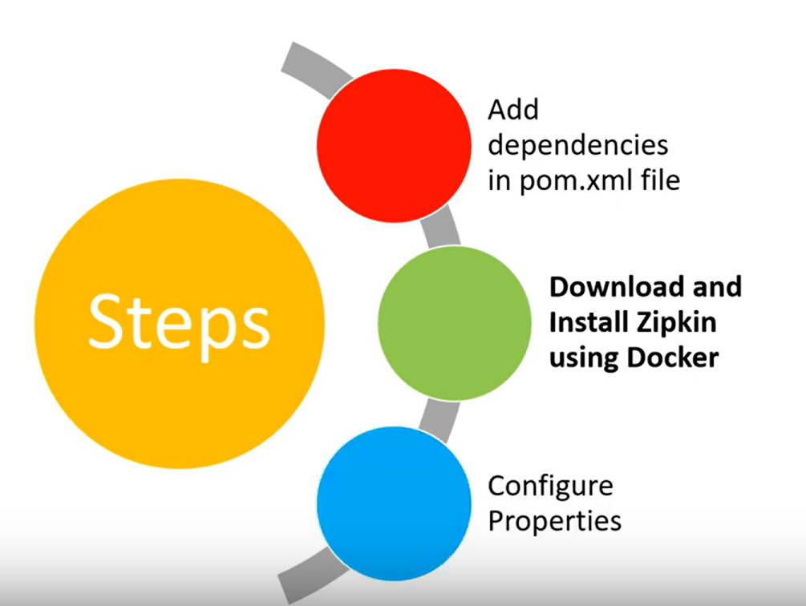
Implement Distributed Tracing using Zipkin

Slide 16
Implement Distributed Tracing using Zipkin
Zipkin Properties and Configuration
management.tracing.sampling.probability = 1.0
If the value is 0 then it will not take any samples for tracing
If the value is 1 then it will take 100% of samples for tracing
If the value is 0.1 then it will take 10% of samples for tracing

Slide 17

Lab: Working with Spring Cloud DT Zipkin
Lab Guide:
https://spring.academy/guides/spring-spring-zipkin

